Slide 1
Analyzing Hard Drive Failures in Cloud Storage
CS 2704 Project Proposal - Nathan McGugan

Slide 2

Data Source – Backblaze Datacenter Hard Drives
Backblaze is a data storage and cloud backup company.
Each quarter, they release statistics on all the hard drives within the data center.
Data is recorded as a CSV file for every day in that quarter
Each row is a unique hard drive.
Over 100,000 drives in each CSV.
I will be covering 1462 days (4 years) of data.

Slide 3
Data management
There are about 130 columns in the raw data, but only the first 5 are useful.
The columns I will use are: 'date', 'serial_number', 'model', 'capacity_bytes’, and 'failure’
Since each CSV contains whether the drive failed that day, grouping all the data together by serial_number is best.
All files will need to be concatenated into one DataFrame (or CSV for easy loading).

Slide 4
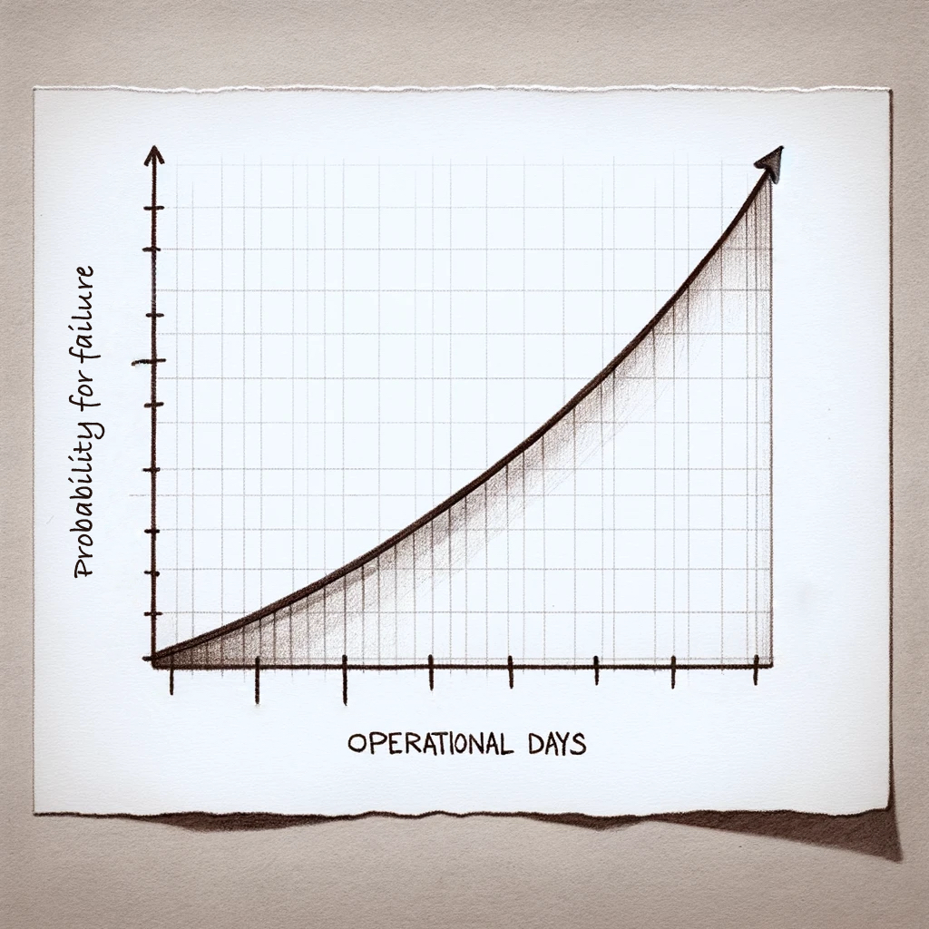
Hypothesis
The likelihood that a hard drive will fail increases over time.
Meaning that we should see a higher failure rate among the oldest hard drives.
My guess is that the hypothesis is true.

Slide 5
Testing the hypothesis
Determine whether operational days have a statistically significant effect on the probability of hard drive failure.
Since the values for days and failures are discrete, we can use Logistic regression for this relationship.
Logistic regression gives the coefficient β1, which shows the direction of the relationship.
The Python module ‘statsmodels’ can accomplish the Logistic regression.

Slide 6
Links
Github: https://github.com/The-Captain8/Data-Analytics-Project
Data: https://www.backblaze.com/cloud-storage/resources/hard-drive-test-data
Data was listed in awesome-public-datasets on github (https://github.com/awesomedata/awesome-public-datasets)

